Slide 1
Information for Parents

Slide 2
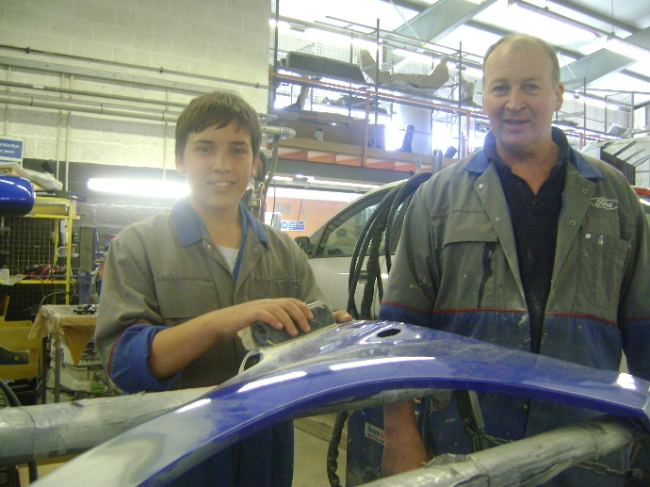
What is Trident Work Experience?
Two-week work experience placement (5 days per week, 10 days in total) that Year 10 students in the island complete.
It is an opportunity to develop important employability and transferrable skills
Gain an insight into the world of work
Work as part of an adult team
Take on commitment and responsibility
Try something that interests them
Help them make post 16 choices

Slide 3
Why do students do Trident?
Gatsby Benchmark 6: Experiences of workplaces
Every pupil should have first-hand experiences of the workplace through work visits, work shadowing and/or work experience to help their exploration of career opportunities and expand their networks.
By the age of 16, every pupil should have had at least one experience of a workplace, additional to any part-time jobs they may have.

Slide 4
Trident Placement Dates 2024
School | Dates
Hautlieu School | Monday 29th January – Friday 9th February
Beaulieu Convent School | Monday 26th February – Friday 8th March
Les Quennevais School | Monday 11th March – Friday 22nd March
Grainville School | Monday 03rd June – Friday 14th June
Victoria College | Monday 03rd June – Friday 14th June
Le Rocquier School | Monday 17th June – Friday 28th June
De La Salle College | Monday 17th June – Friday 28th June
Haute Vallee School | Monday 8th July – Friday 19th July
Jersey College for Girls | Monday 8th July – Friday 19th July

Slide 5
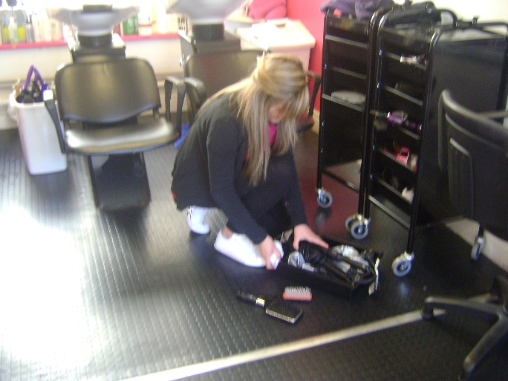
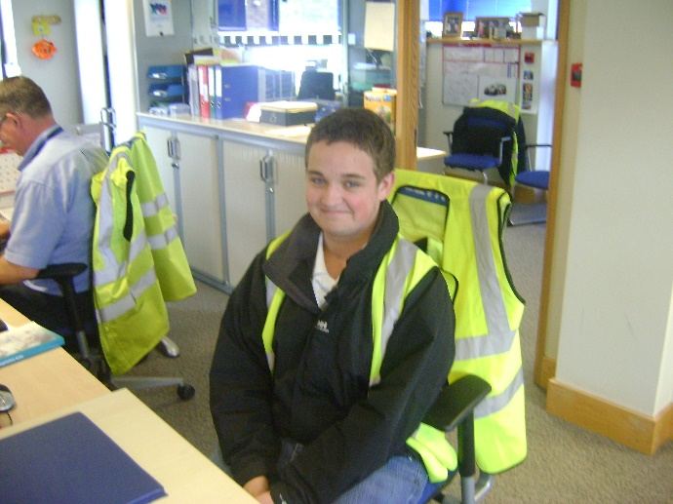
Two Options:
Choose From The Website
OR
Arrange an Own Placement

Slide 6
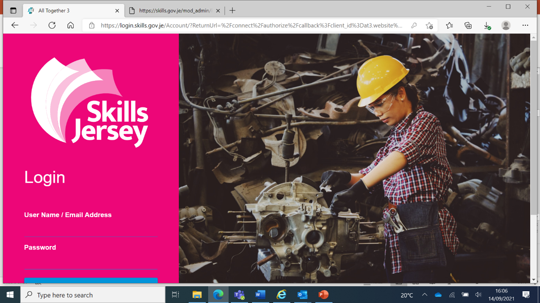

Slide 7
The Trident Website
Student login - username and password (details provided by Trident)
Over 500 opportunities – search by category, business name or activity type
Select six equal choices and then printed.
Choices will be locked once the deadline date has passed
Brief overview of Post 18 options
Key considerations when looking at going to university
One to one appointments with students and parents
Administrate the grant application process
Look at the different ways to gain a University education
Know how to research university choices

Slide 8
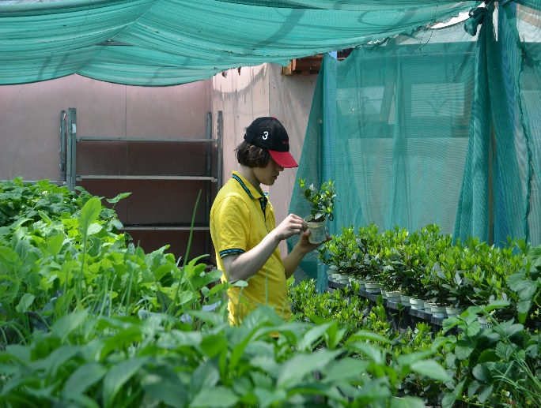
What Opportunities Are Available?
On the website there are currently 512 active opportunities
Finance/Legal*
Hospitality
Retail
Construction
Education
Health
IT/Digital*
and more…

Slide 9
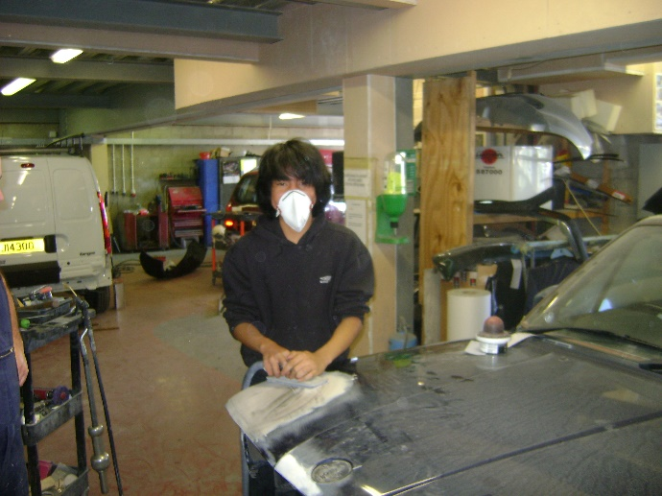
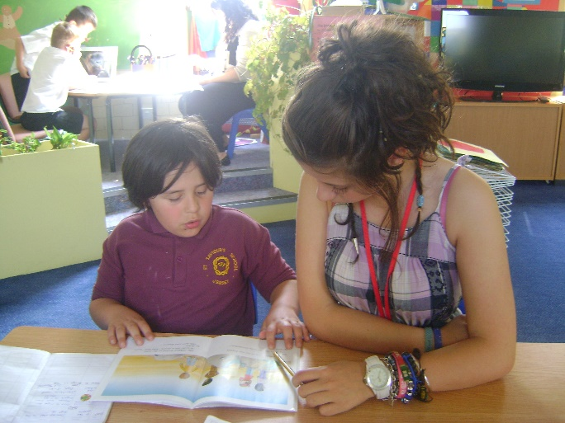
Career Related Linked to vocational studies post-16 Talk about on application forms/personal statements Try it before they commit An insight into the industry, work environment, tasks and expectations | General Experience Transferrable skills Weekend/Summer employment Add to their CV Good preparation for another opportunity Discover their strengths and interests

Slide 10
Things to consider
Location of placement – can they get there?
Hours of work – Monday to Friday 9am to 5pm or flexible/shifts
Do they want to be front or back office?
Do they want a physical or office environment?
Do they want to challenge themselves or continue to develop their current skill set?
Be aware of the health and safety do’s and don’ts
Have realistic expectations of the tasks
Oversubscribed choices
‘Last’ choice – doesn’t exist
Shouldn’t work with close relatives

Slide 11
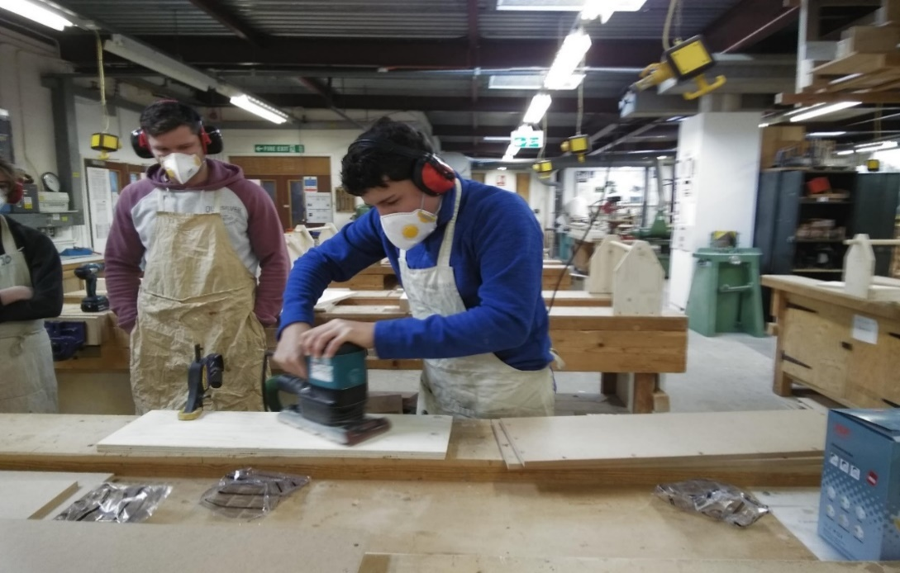
Can be organised in the UK –
Only time students can work with Family
Form can be downloaded from the Trident Website
Own Placement
Company not already part of the Trident scheme and can’t be a Sole Trader
Health & Safety Checks completed by Trident Office
Attach Own Placement Form to main Application Form

Slide 12
The Trident Application Form
On the reverse of the form, students need to complete a personal statement:
Why have they chosen those opportunities
What skills are they hoping to gain
Do they have any relevant interests or hobbies
Final Checks:
That handwriting is legible or submit a typed statement
A parent/guardian has signed the form signature & circled the relevant health box
The form must be handed in before the deadline

Slide 15
Example Personal Statement
I have made these choices as I have a variety of interests that I would be interested in trying out.
I chose two nursery settings as I am currently studying Childhood Development for one of my GCSE’s therefore, I would love to gain some real-life experience working within this environment and put what I am learning into practice.
I have also chosen two Trainee Chef opportunities as in my spare time my favourite hobby is cooking and baking for my family and friends. My speciality dish is chicken stir fry and I have recently perfected my chocolate brownies!
Finally, I have chosen a couple of opportunities within construction, as I am considering applying for a course at Highlands within this area therefore it would be great to gain an insight into all the different roles to see what I prefer.
I am a reliable and mature student who would do well in any of the placements, and I am looking forward to being more independent by making my own travel arrangements to get to and from work on time. I hope to develop my communication skills and confidence working with adults as a team.

Slide 16
Student Application Deadline
Placement Period | Deadline Date
January to March placements | Monday 16th October
June to July placements | Monday 20th November

Slide 17
Discuss different options with your child
Don’t focus too much on careers
How to support your child during this process
Check that you are both happy with the placement description, working hours & the location
Prepare them for the realities of the working day
Help them to plan their journey to work
Encourage them to prepare for the interview

Slide 18
Parental responsibility during work experience
Trident is part of each child’s school curriculum and is not optional.
All students are expected to undertake the full two weeks of work experience.
Trident is a challenging activity which is outside of your child’s comfort zone. They may struggle with the placement initially. Please support and encourage your child to persevere – it will become easier and they will achieve a sense of accomplishment by completing the placement.
It is the parent’s responsibility to inform the employer if your child is not attending. This should be done each day. The school should also be informed
Only students who successfully complete 80% or more of their Trident period will receive a certificate and Employer Reference to use for Post 16 choices and future employment.

Slide 19
The Trident Process
Allocation process
Reselections / early interviews
Final confirmation - three weeks before placement (unless early interview)
Arranging interview
School monitoring
Students can be sent back to school
Use of Social Media
Employer reports
Brief overview of Post 18 options
Key considerations when looking at going to university
One to one appointments with students and parents
Administrate the grant application process
Look at the different ways to gain a University education
Know how to research university choices

Slide 20
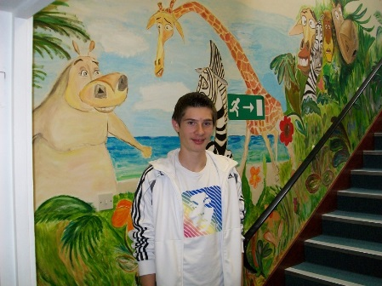
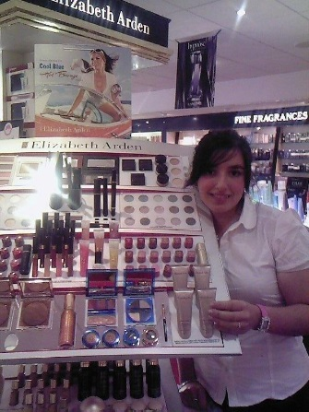
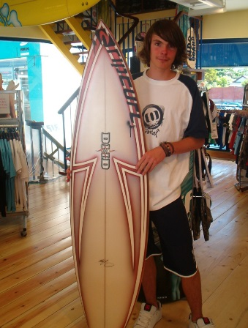
“Hannah has shown a keen eye for detail and was able to complete all tasks efficiently and to our high standards. She displayed a real thirst for knowledge and had a constant goal of self improvement. I feel Hannah has a natural flare for cooking and would work well within any team” Chef, Longueville Manor Hotel.
“Brandon engaged with customers and staff from day one. He was keen to assist with all aspects involved in running a sports centre. He was self motivated and always looking for jobs to do.” Manager, Les Quennevais Sports Centre.

Slide 21
“I met with Conor to advise him that I felt he had let himself down during his placement. He frequently used his phone to play games and text during working hours. He seemed disinterested and bored and his comments and actions were disrespectful to the people he was working amongst.” HR Manager, Ogier

Slide 22
449440
gov.je/skillsjersey
trident@gov.je
CONTACT US
skillsjersey
skills_jersey

Slide 23
An Island wide Skills Service

